Slide 1

Low Light Image Enhancement
Amol Srivastava 101903067
Gurleen Kaur 101903399
Devansh Mathur 101915093
Mentor : Dr Rohan Sharma
Co-Mentor : Dr Deepshikha Tiwari
CPG number : 249

Slide 2
01
BACKGROUND OF PROJECT
02
SCOPE AND UTILITY OF THE PROJECT
03
OBJECTIVES
04
LITERATURE SURVEY
05
ARCHITECTURE OF THE PROJECT
TABLE OF CONTENTS
06
TECHNIQUES AND TOOLS USED
07
SNAPSHOTS OF PROJECT
08
METHODOLOGY
09
WORK BREAKDOWN STRUCTURE
10
PERFORMANCE ANALYSIS
11
KEY DELIVERABLES OF THE PROJECT
12
PROFESSIONAL AND TECHNICAL LEARNING
13
INDIVIDUAL ROLES AND LEARNING OUTCOMES

Slide 3
BACKGROUND OF PROJECT
It has been observed many photos are often captured under suboptimal lighting conditions due to inevitable environmental which includes inadequate and unbalanced lighting conditions in the environment.
Such low-light photos suffer from compromised aesthetic quality and unsatisfactory transmission of information.
The aim of low-light image enhancement is to enhance details of an image for better observation and studying.
The scope of this project is to show the potential of training a deep image enhancement model in the absence of reference images through task-specific non-reference loss functions that indirectly evaluate enhancement quality.
This can be used to enhance the quality of images captured by CCTV cameras during night time and also in general images captured in low lit environment.

Slide 4
SCOPE AND UTILITY OF THE PROJECT
To demonstrate a low-light enhancement network that is independent of paired and unpaired training data, thus avoiding the risk of overfitting.
To design an image-specific curve that is able to approximate pixel-wise and higher-order curves by iteratively applying itself. Such image-specific curves can effectively perform mapping within a wide dynamic range.
To show the potential of training a deep image enhancement model in the absence of reference images through task-specific non-reference loss functions that indirectly evaluate enhancement quality.

Slide 5
OBJECTIVES
Research on different techniques
Quantitative analysis of results
Research and analyze already existing different low light image enhancement techniques
Analyzing the output images using some quantitative measures
1
4
Build the Model
User Interface Design
Build an efficient and robust model using Python, capable of enhancing brightness and tones of images captured in low lighting conditions
Building a mobile user interface to make the model easily accessible
2
5
Quality check of output images
Integrate model with application
To keep the dimensions and extensions of output images same as input images but with enhanced features
Integrating the ML model in the mobile application by converting the model into tflite format
3
6

Slide 6
LITERATURE SURVEY
Paper title | Tools/Technology | Findings
Zero-Reference Deep Curve Estimation for Low-Light Image Enhancement | Python, DCE(Deep Curve estimation) technique, DL neural network | Zero-Reference Deep Curve Estimation (Zero-DCE), which formulates light enhancement as a task of image-specific curve estimation with a deep network.
EnlightenGAN: Deep Light Enhancement without Paired Supervision | Python, Generative Adversarial Network(GAN) | Highly effective unsupervised generative adversarial network, dubbed EnlightenGAN, that can be trained without low/normal-light image pairs, yet proves to generalize very well on various real-world test images
Underexposed Photo Enhancement Using Deep Illumination Estimation | Python, c++, Deep Learning | Intermediate illumination in the network to associate the input with expected enhancement result, which increases the network's capability to learn complex photographic adjustment from input/output image pairs

Slide 7
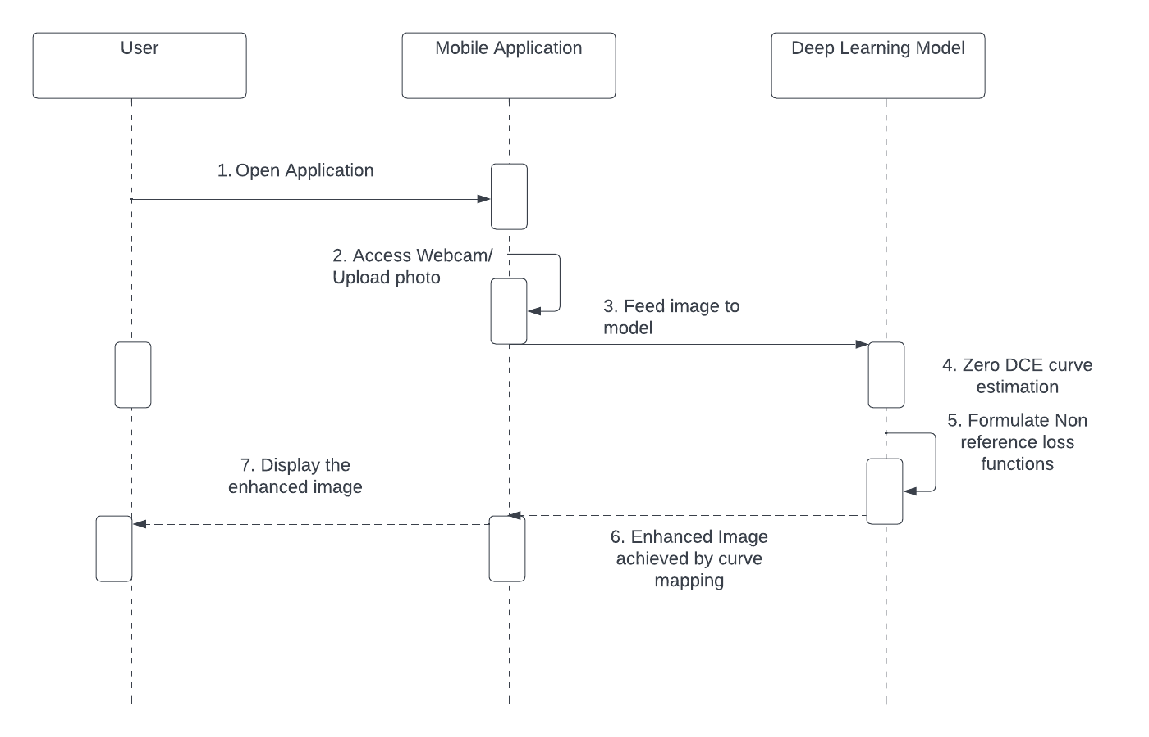
ARCHITECTURE OF THE PROJECT
SEQUENCE DIAGRAM
This sequence diagram is depicting interaction between objects in a sequential order i.e. the order in which these interactions are taking place. It describes how and in what order the objects in our project are functioning..

Slide 8

Techniques and Tools Used
01
Python 3.7
07
VS Code as platform
02
Pytorch 1.0.0
03
Opencv
04
Torchvision 0.2.1
05
Cuda 10.0
06
Numpy and Pandas

Slide 9
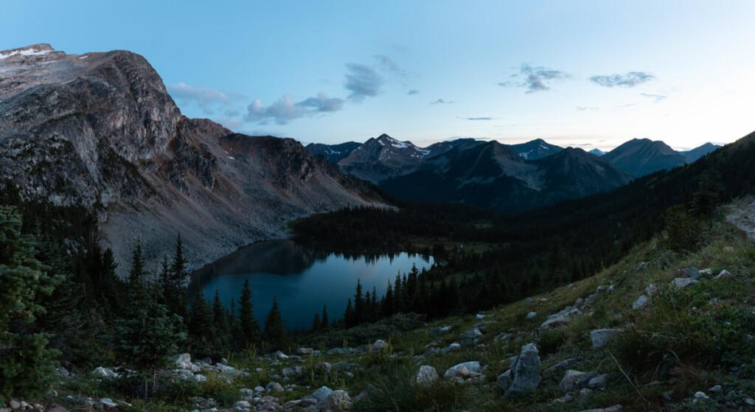
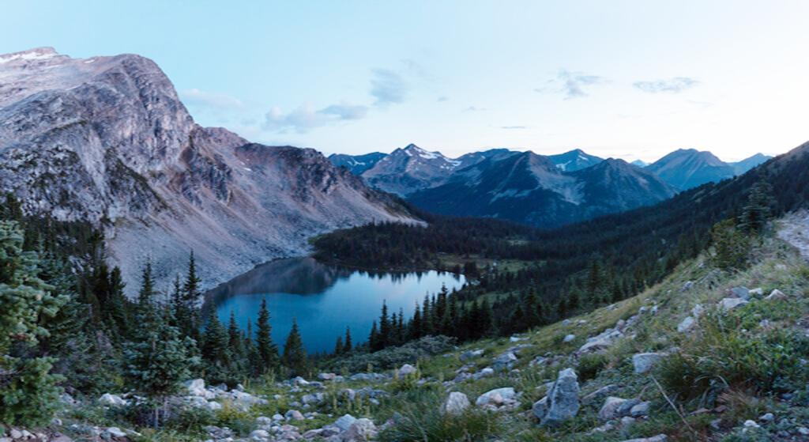
SNAPSHOTS OF PROJECT
Enhanced Image
Original Image

Slide 10

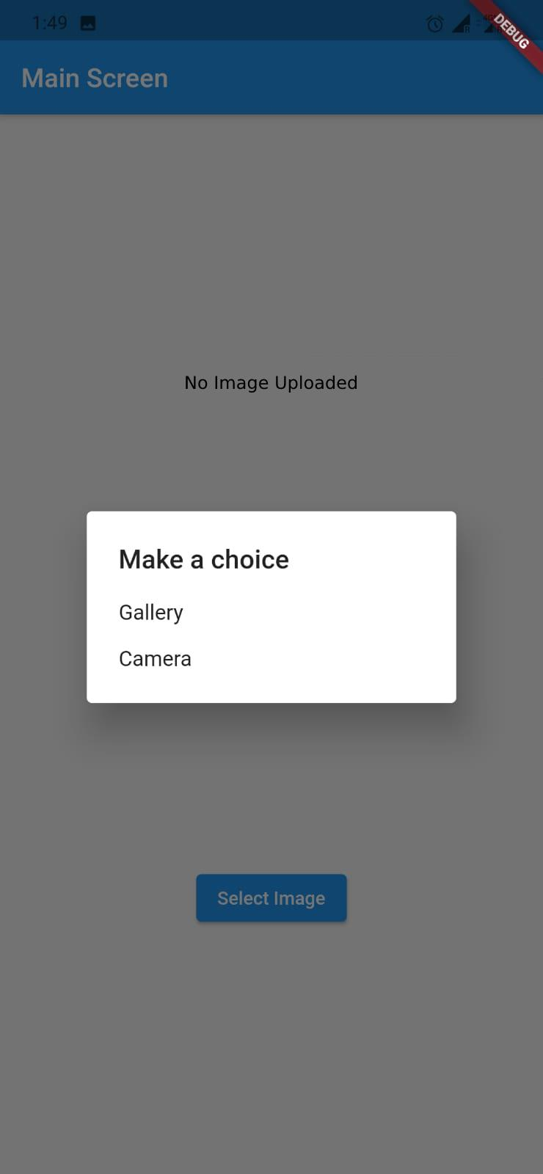
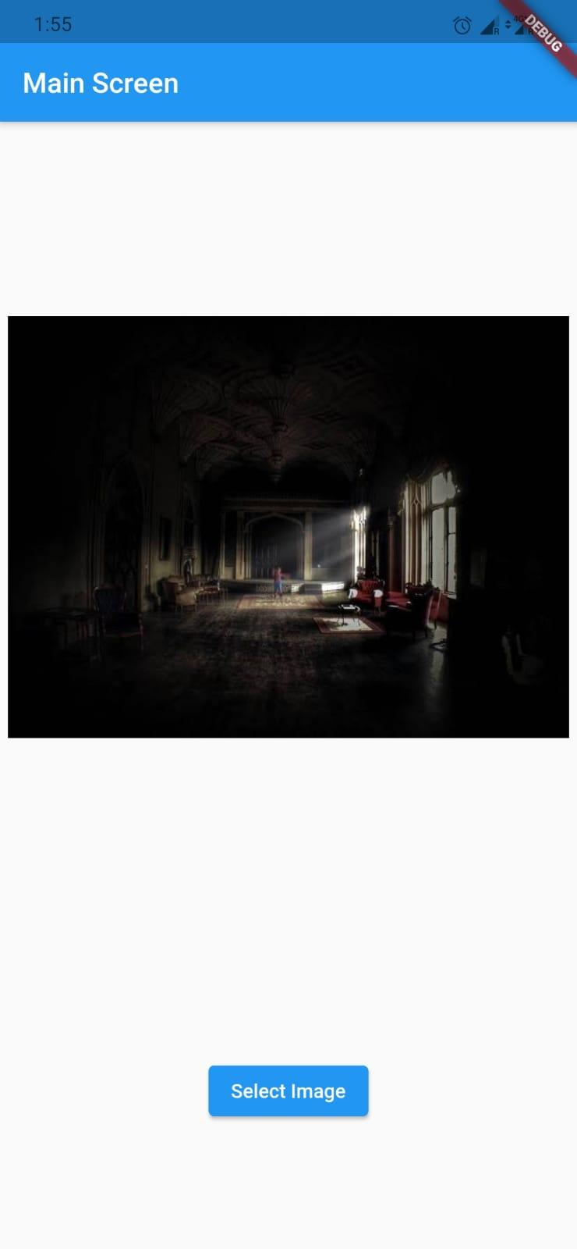
SNAPSHOTS OF PROJECT
MOBILE APPLICATION SNAPSHOTS

Slide 11
METHODOLOGY
Inspired by the curve adjustment used in photo editing software, we attempt to design a kind of curve that can map a low-light image to its enhanced version automatically, where the self-adaptive curve parameters are solely dependent on the input image. Objectives are each pixel value of the enhanced image should be in the normalized range of [0,1] and monotonous curve
For the stick used for navigating through path, we would use ultrasonic sensor for detecting distance from obstacles present at a distance less than one meter and would send it to app using Wi-Fi module and the Alan voice assistant would be used to send the information to the user in voice format
Recognition of text from image or document is done using ML kit of google firebase

Slide 12
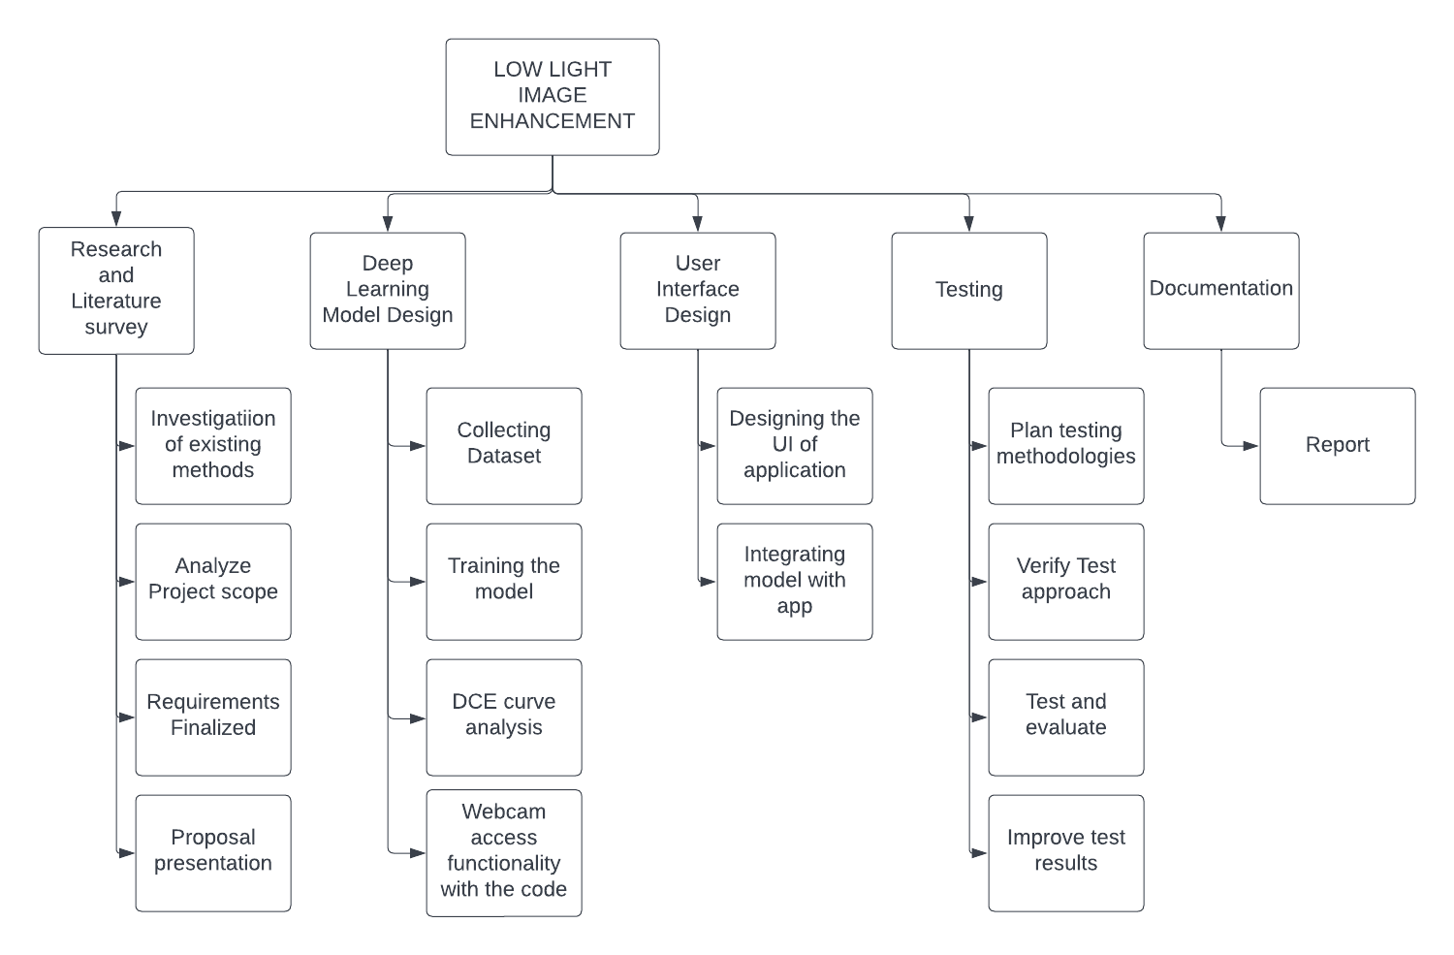
WORK BREAKDOWN STRUCTURE
This Work breakdown structure is a visual, hierarchical and deliverable-oriented deconstruction of our project.It allows us to break down our project scope and visualize all the tasks required to complete the project.

Slide 13
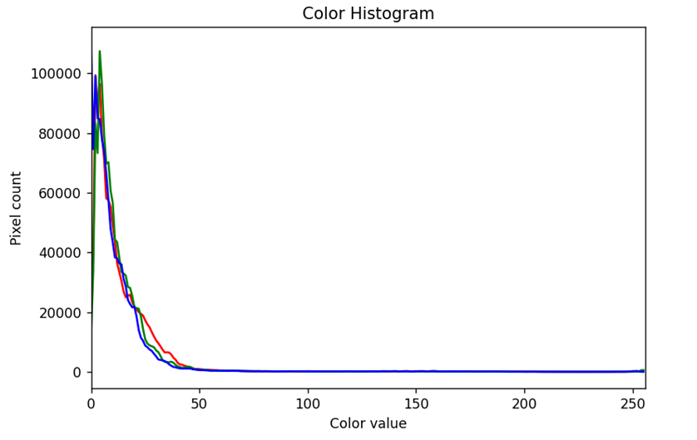
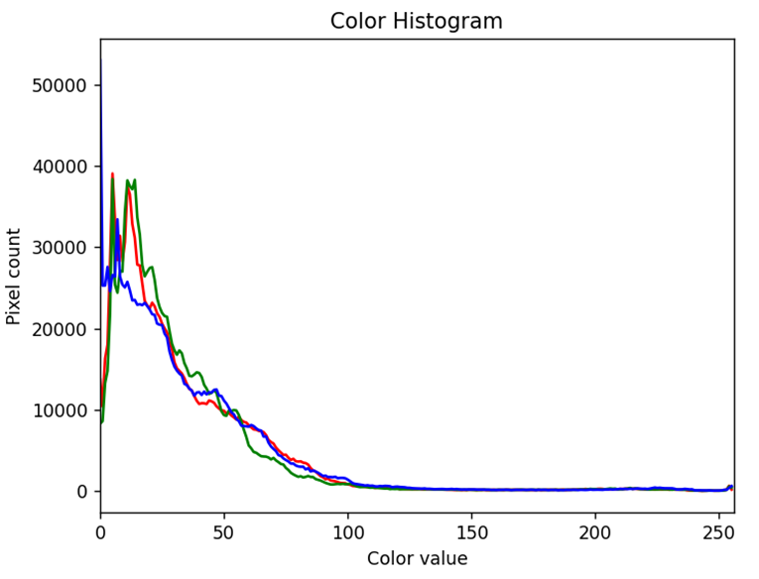
PERFORMANCE ANALYSIS
Histogram for Original Image
Histogram for Enhanced Image
The Histograms are comparing the frequency of pixels for each color value of Original Image and Enhanced Image.In the enhanced image the histogram is more spread out. This shows that the frequency of the dark pixels has decreased and the frequency of coloured pixels has increased.

Slide 14
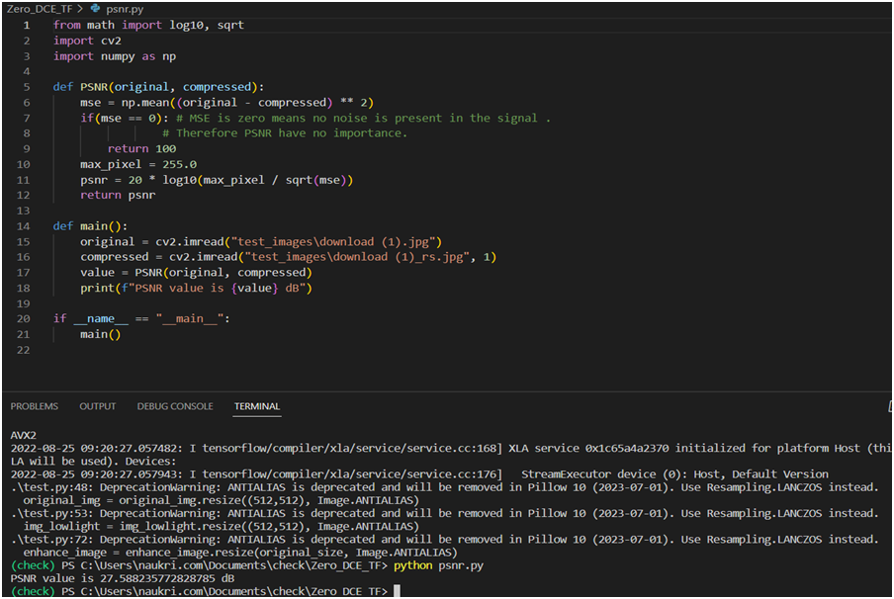
PERFORMANCE ANALYSIS
The PSNR computes the peak signal-to-noise ratio, in decibels, between two images. This ratio is used as a quality measurement between the original and an enhanced image. The higher the PSNR, the better the quality of the enhanced image.
The PSNR value of enhanced image came out to be 27.58823 dB.

Slide 15
KEY DELIVERABLES OF THE PROJECT
A model that can improve the perception or interpretability of an image captured in an environment with poor illumination.
A mobile application with a simple use interface that accepts an image through a camera or an existing image and after model integration, it will produce the enhanced image on the app itself.

Slide 16
PROFESSIONAL AND TECHNICAL LEARNING
Through this project we learnt various Computer Science concepts like -
Machine learning-We used Machine Learning concepts to train and test our model on the dataset.
Deep Learning -We used the knowledge of Neural Networks in Deep Learning to create our model,the knowledge of Convolutional Neural Networks to create our model.
Mobile Application development-To create the front end of our mobile Application we used flutter programming language.

Slide 17
INDIVIDUAL ROLES AND LEARNING OUTCOMES
Amol Srivastava
Gurleen Kaur
Devansh Mathur
Report preparation
Dataset Manipulation
Model training
Preprocessing
App development
Model training
Dataset Manipulation
Documentation
Quantitative analysis

Slide 18
INDIVIDUAL ROLES AND LEARNING OUTCOMES
We learnt to apply mathematical concepts and engineering techniques to obtain analytical solutions.
We were able to design the software system to address desired needs.
We learnt to code in different programming languages and apply different data structures and algorithmic techniques.

Slide 19

THANK YOU
Amol Srivastava 101903067
Gurleen Kaur 101903399
Devansh Mathur 101915093

